Slide 1

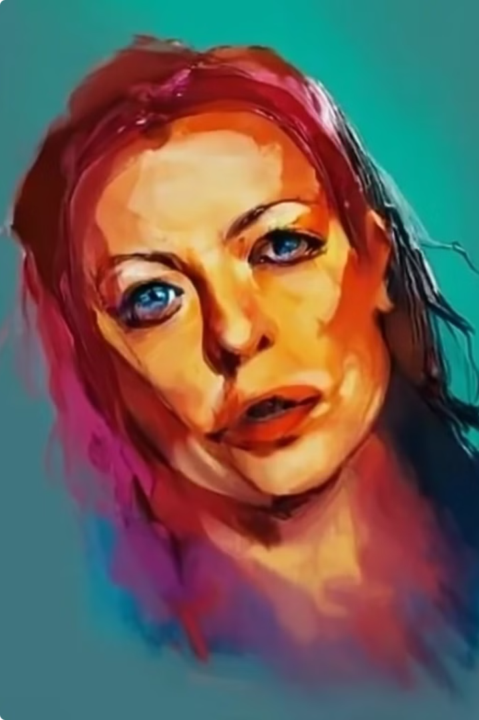
Introduction to Image Caption Generation
Image caption generation is a fascinating area of artificial intelligence that aims to automatically describe the content of images. It involves training computer models to understand visual information and translate it into meaningful text.

Slide 2
The Importance of Image Captioning
Image captioning enhances accessibility by providing textual descriptions for visually impaired individuals. It also enables efficient image retrieval and indexing, allowing users to search for images based on their content.
1
Accessibility
2
Image Retrieval
Image captions are crucial for making images accessible to visually impaired individuals.
Image captions enable users to search for images based on their content.
3
Content Understanding
4
Automated Image Description
They provide a concise summary of the image, enhancing content understanding and analysis.
Image captioning automates the process of providing descriptions for images, saving time and effort.

Slide 3
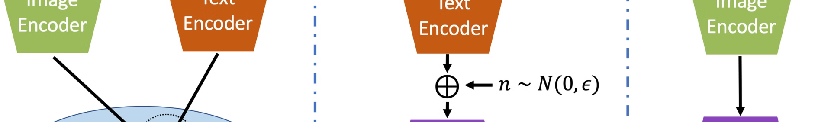
How Image Captioning Works
Image captioning models typically employ a combination of computer vision and natural language processing techniques. They first extract features from the image, then use those features to generate a textual description.
Image Feature Extraction
Computer vision models analyze the image and extract features like objects, shapes, colors, and textures.
Output
The final output is a textual description that accurately reflects the image content.
1
2
3
Text Generation
Natural language processing models use the extracted features to generate a grammatically correct and meaningful caption.

Slide 4
Key Techniques in Image Captioning
There are several popular techniques used in image captioning, including Convolutional Neural Networks (CNNs) for image feature extraction and Recurrent Neural Networks (RNNs) for text generation.
CNNs
RNNs
Attention Mechanisms
Convolutional Neural Networks excel at image feature extraction, identifying objects, shapes, and colors.
Recurrent Neural Networks are effective for generating sequential text data, like captions, by capturing relationships between words.
Attention mechanisms help focus the model's attention on the most relevant parts of the image, improving caption quality.

Slide 5
Challenges in Image Captioning
Image captioning faces challenges like handling complex scenes, recognizing fine-grained details, and understanding nuanced relationships between objects.
Complex Scenes
Multiple objects, actions, and contexts make it difficult to generate comprehensive captions.
Fine-grained Details
Recognizing small details, such as facial expressions or subtle actions, can be challenging.
Nuanced Relationships
Understanding the relationships between objects, like cause and effect or spatial arrangements, requires advanced reasoning abilities.

Slide 6
Applications of Image Captioning
Image captioning finds diverse applications in various domains, from social media to healthcare, enabling better understanding and interaction with visual data.
Social Media
E-commerce
Automatic image descriptions enhance accessibility and engagement on social platforms.
Image captions improve product searches and descriptions, enhancing online shopping experiences.
Healthcare
Robotics
Image captioning aids in medical image analysis, assisting doctors in diagnosing and treating patients.
Robots can better understand their environment and interact with objects using image captioning.

Slide 7




Evaluating Image Captioning Models
Evaluating image captioning models involves assessing their ability to generate accurate, fluent, and relevant captions using various metrics.
BLEU Score
Measures the similarity between generated captions and human-written captions.
ROUGE Score
Evaluates the overlap of words between generated captions and reference captions.
CIDEr Score
Focuses on the semantic similarity and coherence of the generated caption.

Slide 8



Conclusion and Future Directions
Image captioning has made significant progress, but future research aims to improve its ability to handle complex scenes, understand context, and generate more nuanced and creative descriptions.
Advanced Scene Understanding
Contextual Awareness
Creative Captioning
Enabling models to consider the broader context of the image, including the environment and the relationships between objects.
Generating captions that are not only accurate but also engaging and creative, reflecting different perspectives and styles.
Developing models that can analyze and understand complex scenes with multiple objects and actions.

